Slide 1

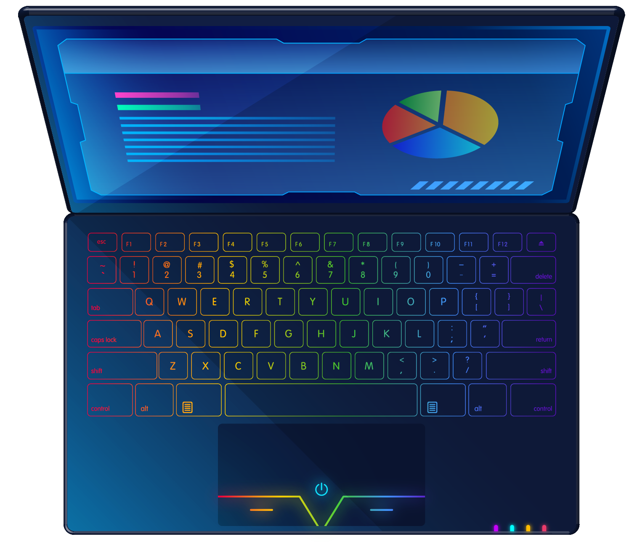
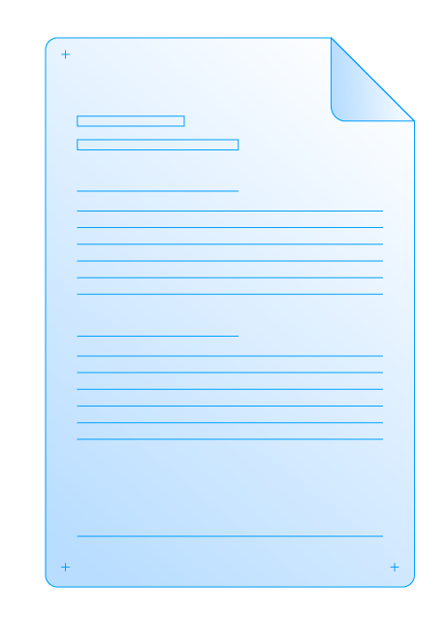
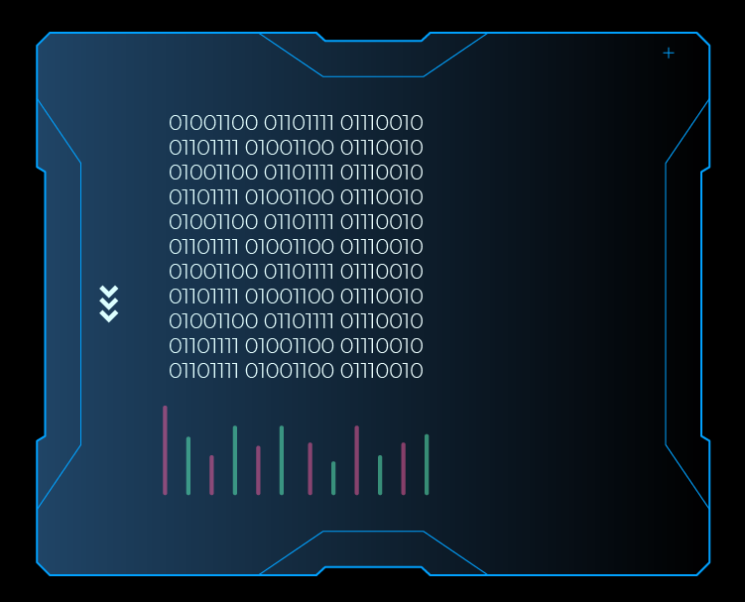
Project work: «Design and Implementation of a rental house management system»
Eurasian National University named after L.N. Gumilyov
Faculty of «Information Technologies»
Department of «Information Systems»
Student: Iskakov Y. K.
Group: IS
Checked by: prof. Zhukabayeva. T. K.

Slide 2
Table of contents
01
02
03
04
05
06
Goals and objectivies
Database
System
Project Planning using Jira
Describing system through UML’s
Conclusion

Slide 3

Introduction
By using technology, this system wants to emphasize all rental listings onto a single platform, simplifying the process for both homeowners and renters by allowing homeowners to easily connect with potential tenants.
The House Rental Management System's primary aim is to provide a thorough, user-friendly platform that makes renting out houses easier. .
Using Java Swing, create a simple and attractive interface that is easy to use for all kinds of users.
Use PostgreSQL to build a strong backend
Offer basic functions like user registration, login, filtering houses, making offers, purchasing properties, and price-based listing sorting.

Slide 4
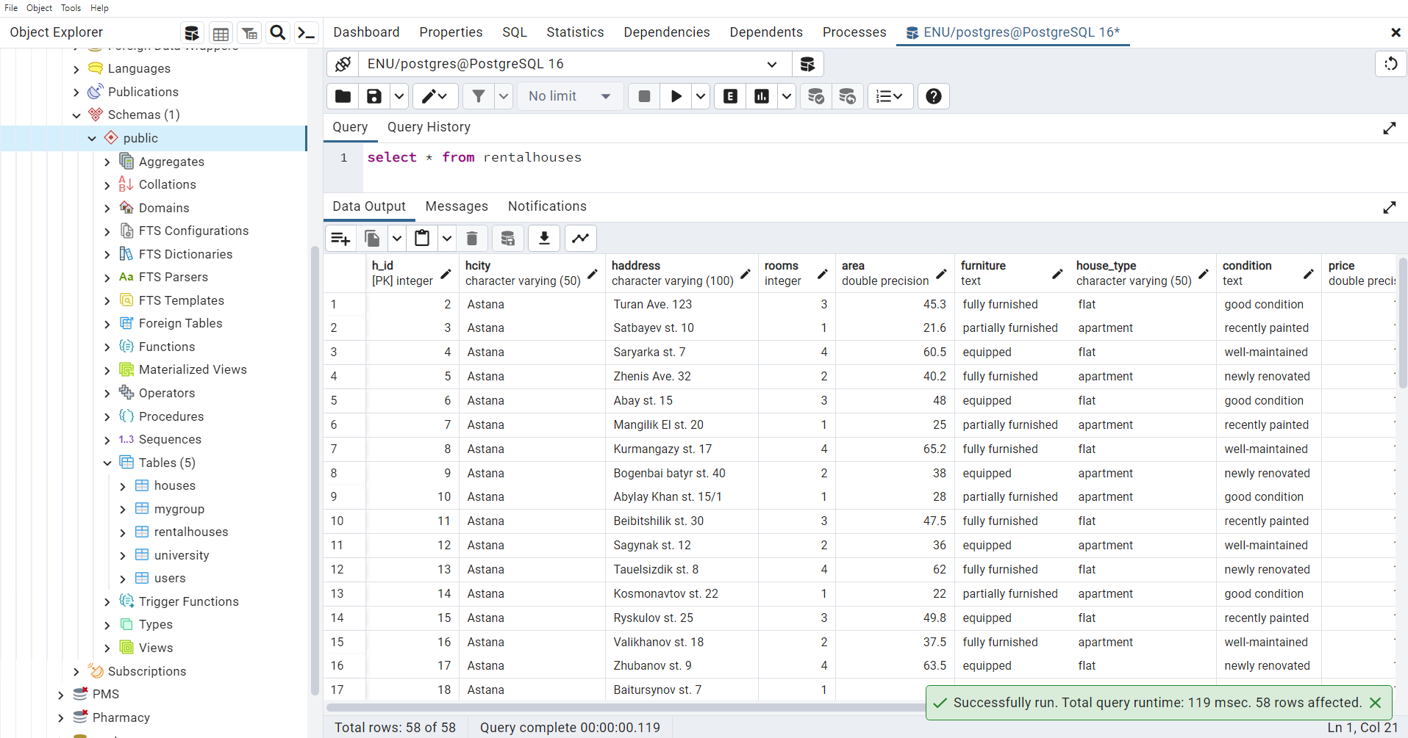
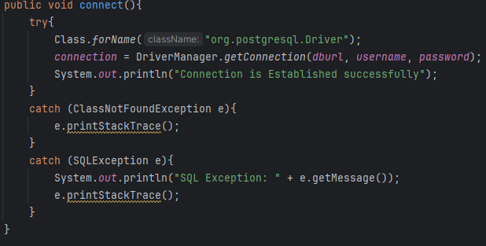
Database
A database is an organized collection of structured information, or data, typically stored in the computer system. Ok, we found that its place where we store our data.

Slide 5
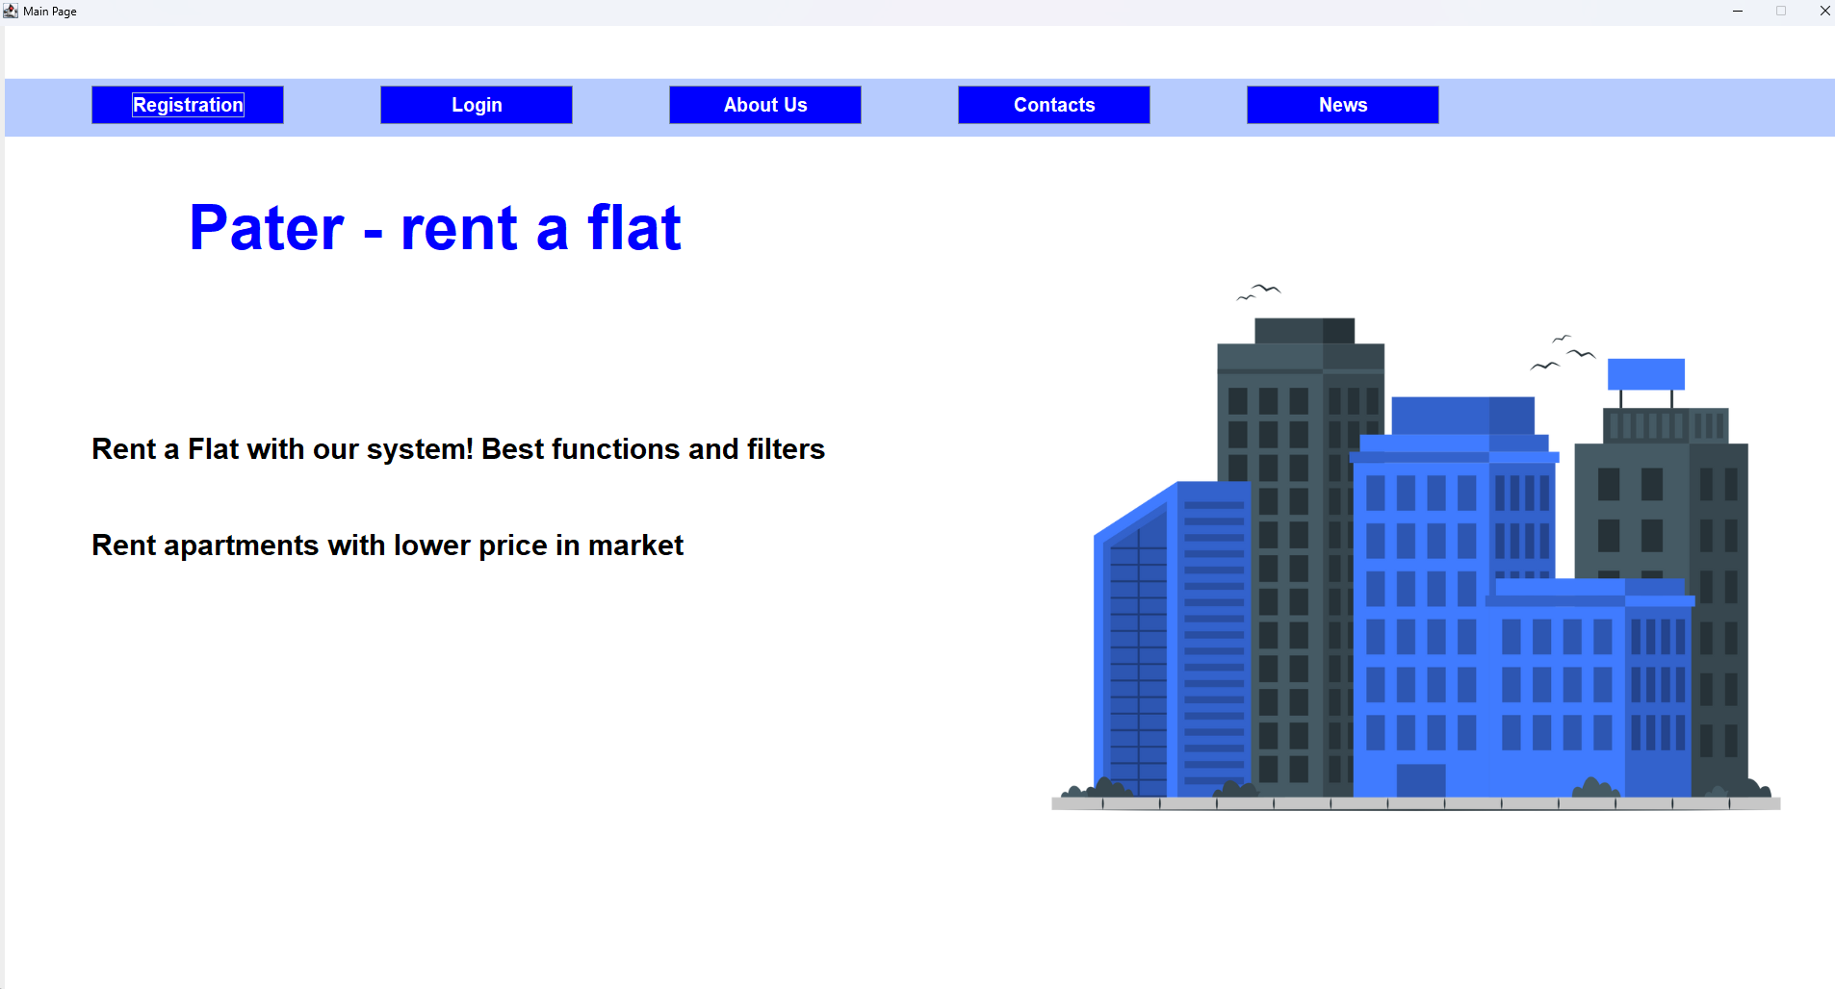
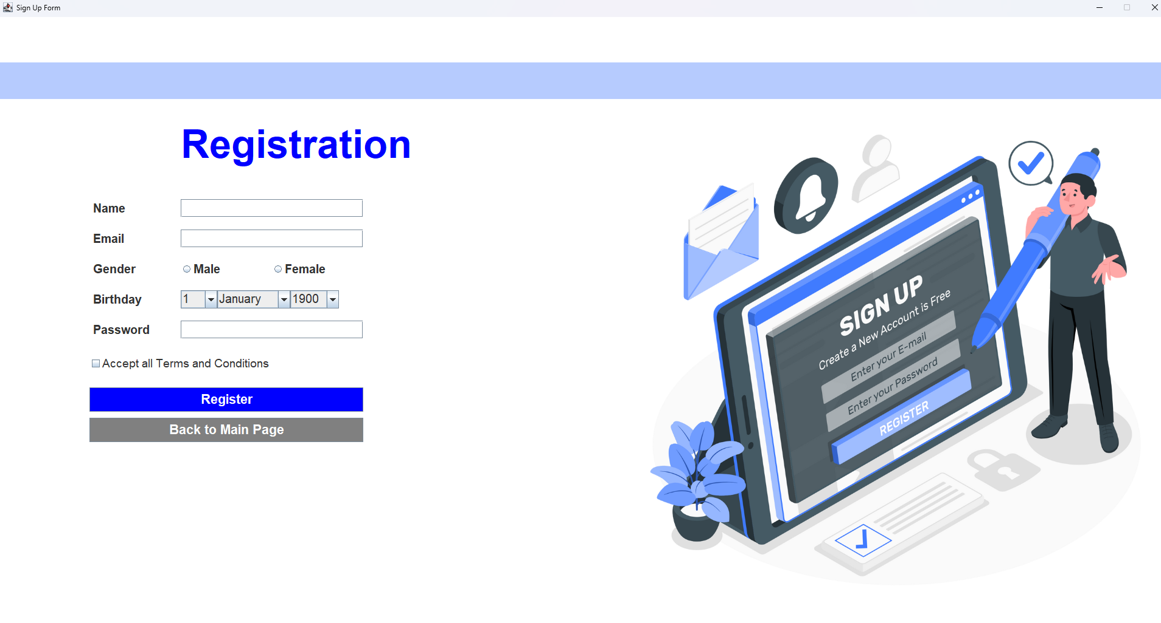
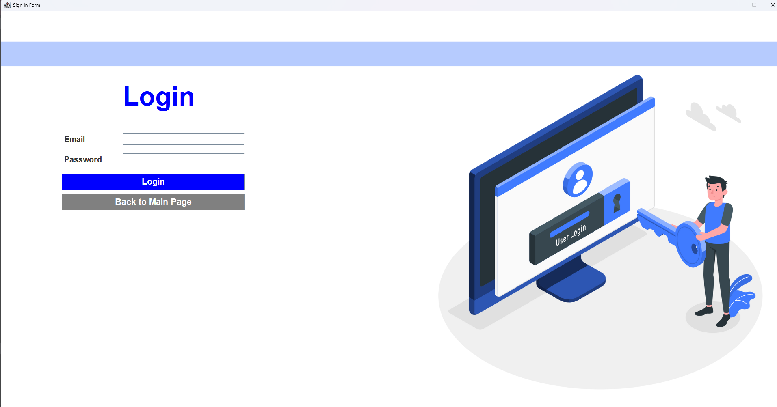
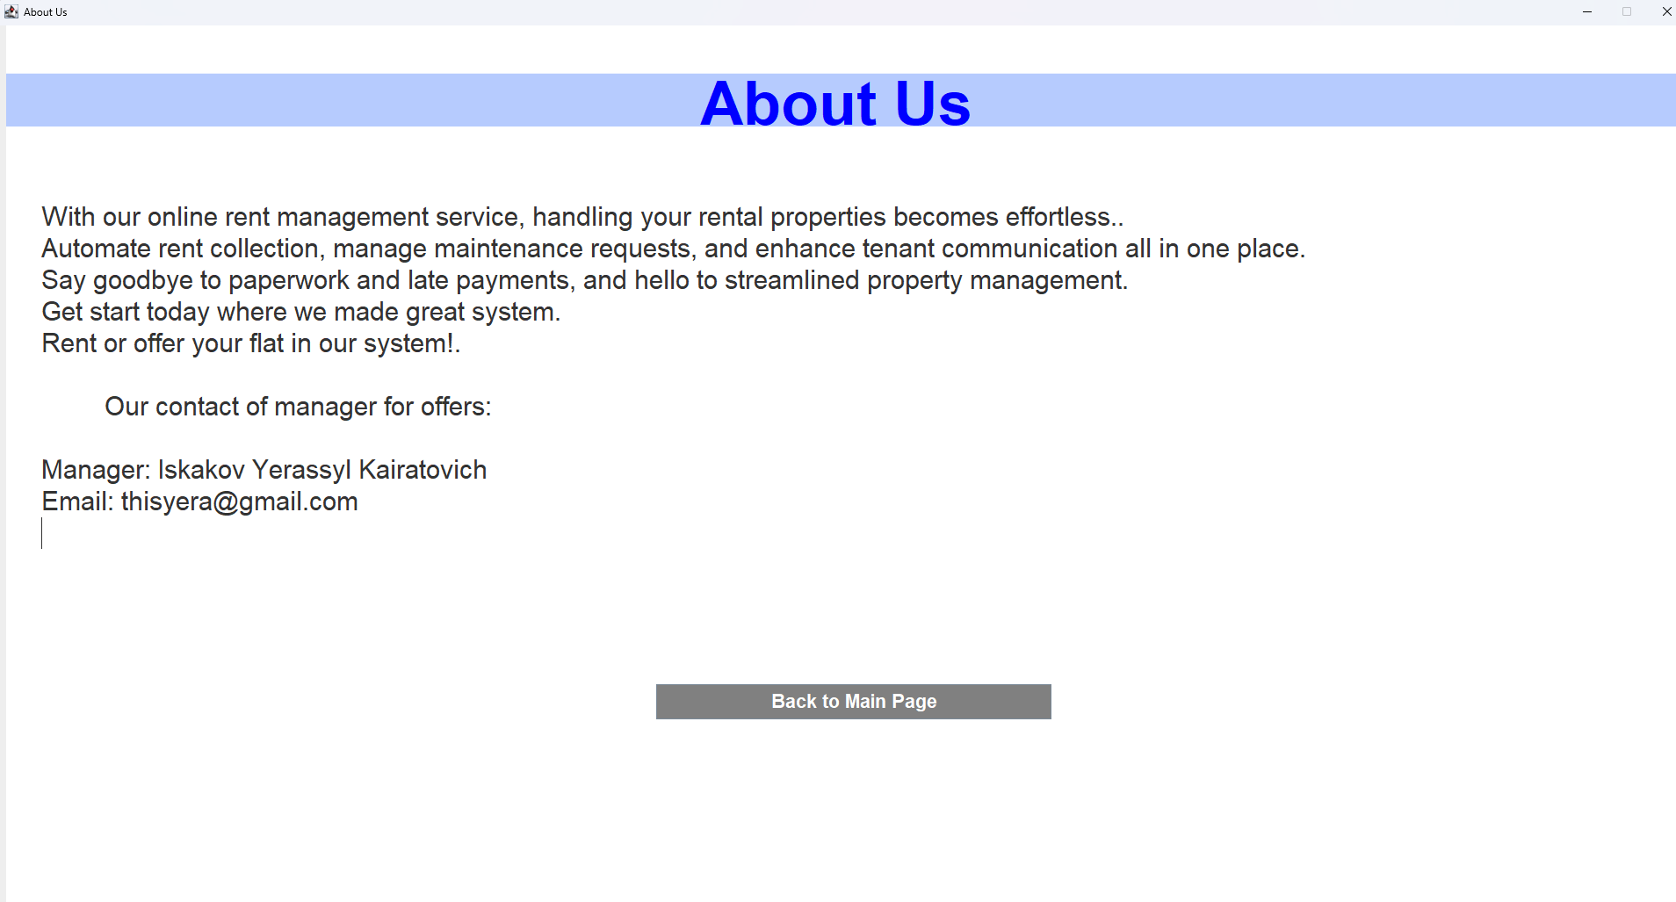
System

Slide 6
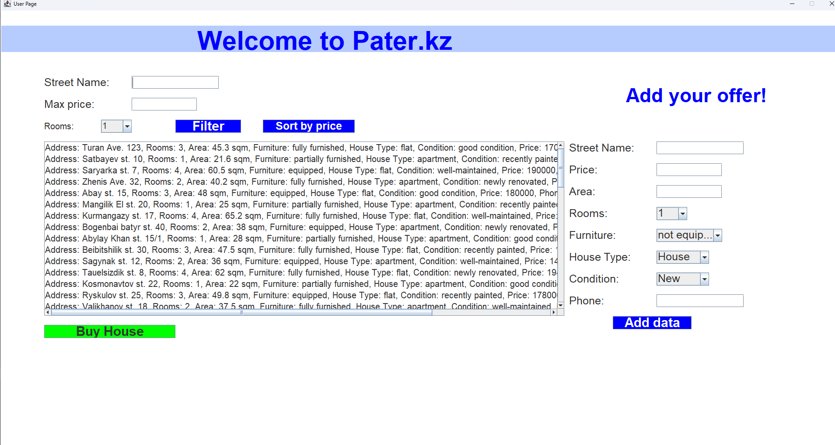
System

Slide 7
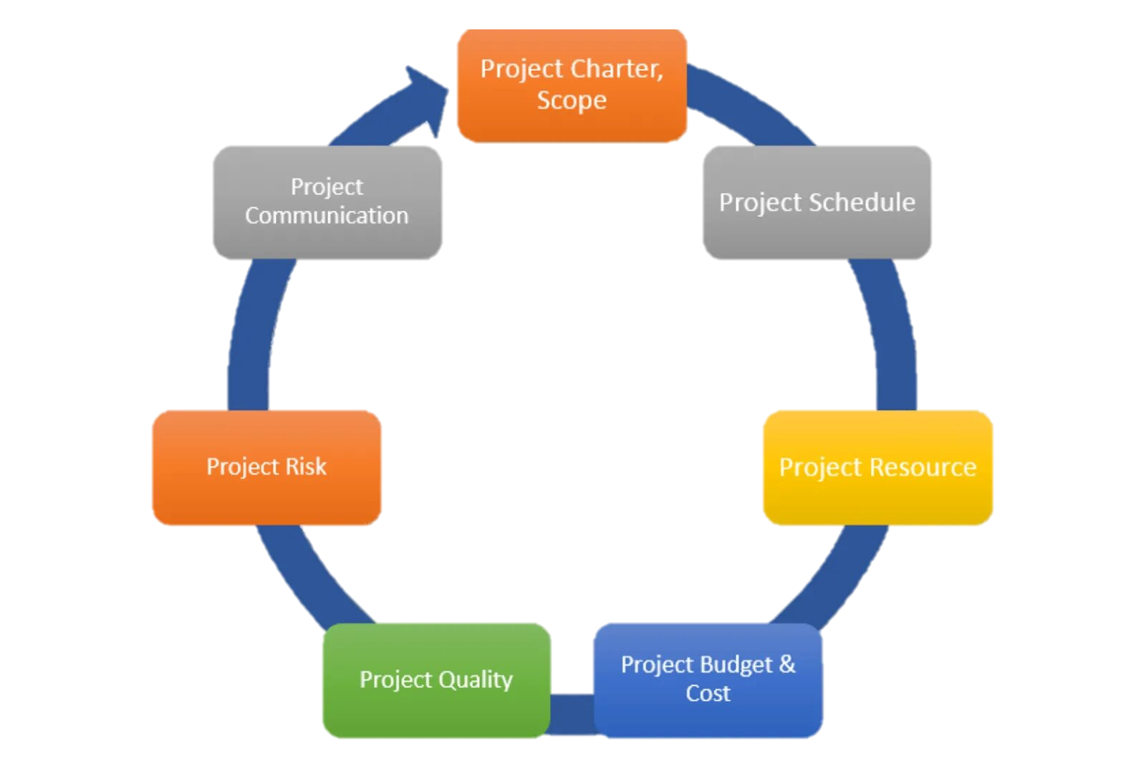
Project planning
Every project has its own start and end, but sometimes they don’t have precise beginning and ending dates (Lock, 2013). All projects are temporary and undertaken to create a product, service, or result, the period between the start and end of the project is referred to as the project life cycle
To develop the project schedule, the project manager analyzes the project scope and purposes which helps him define the project deliverables.

Slide 8
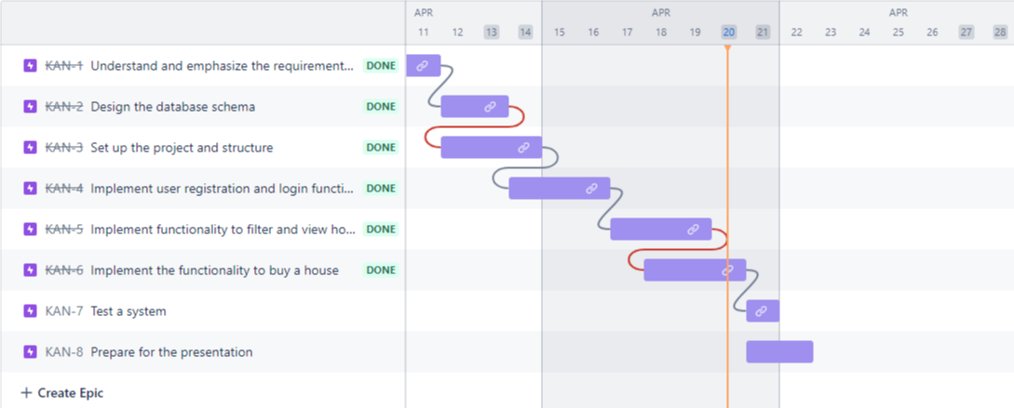
Project planning

Slide 9
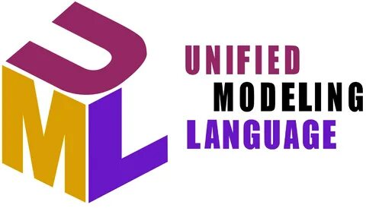
Describing system through UML
UML is used to visually describe a system, including its major actors, roles, actions to better understand, edit, maintain system information.

Slide 10
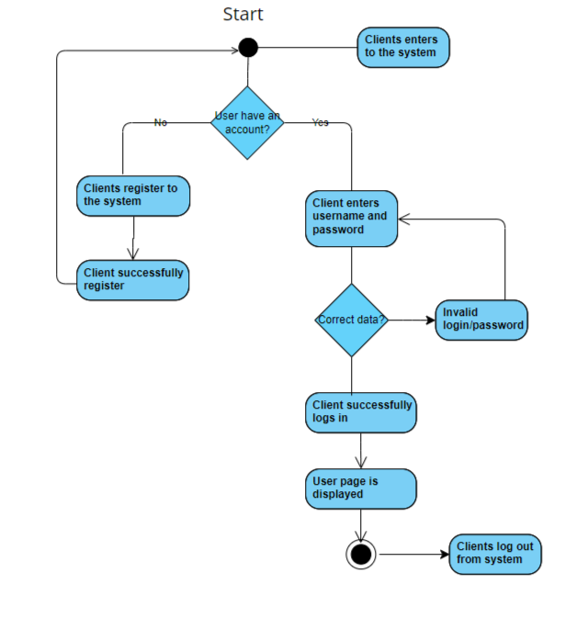
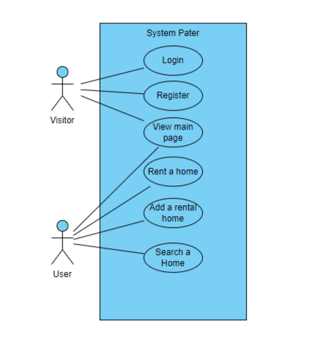
Describing system through UML
Login activity of the client
Use case diagram
Note: Model was developed using Visual Paradigm

Slide 11
Result of the work

Slide 12
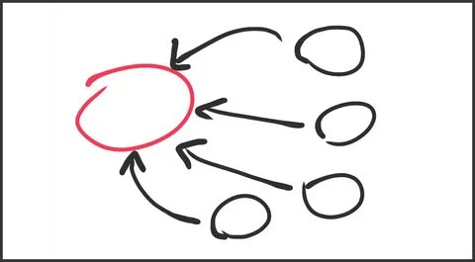
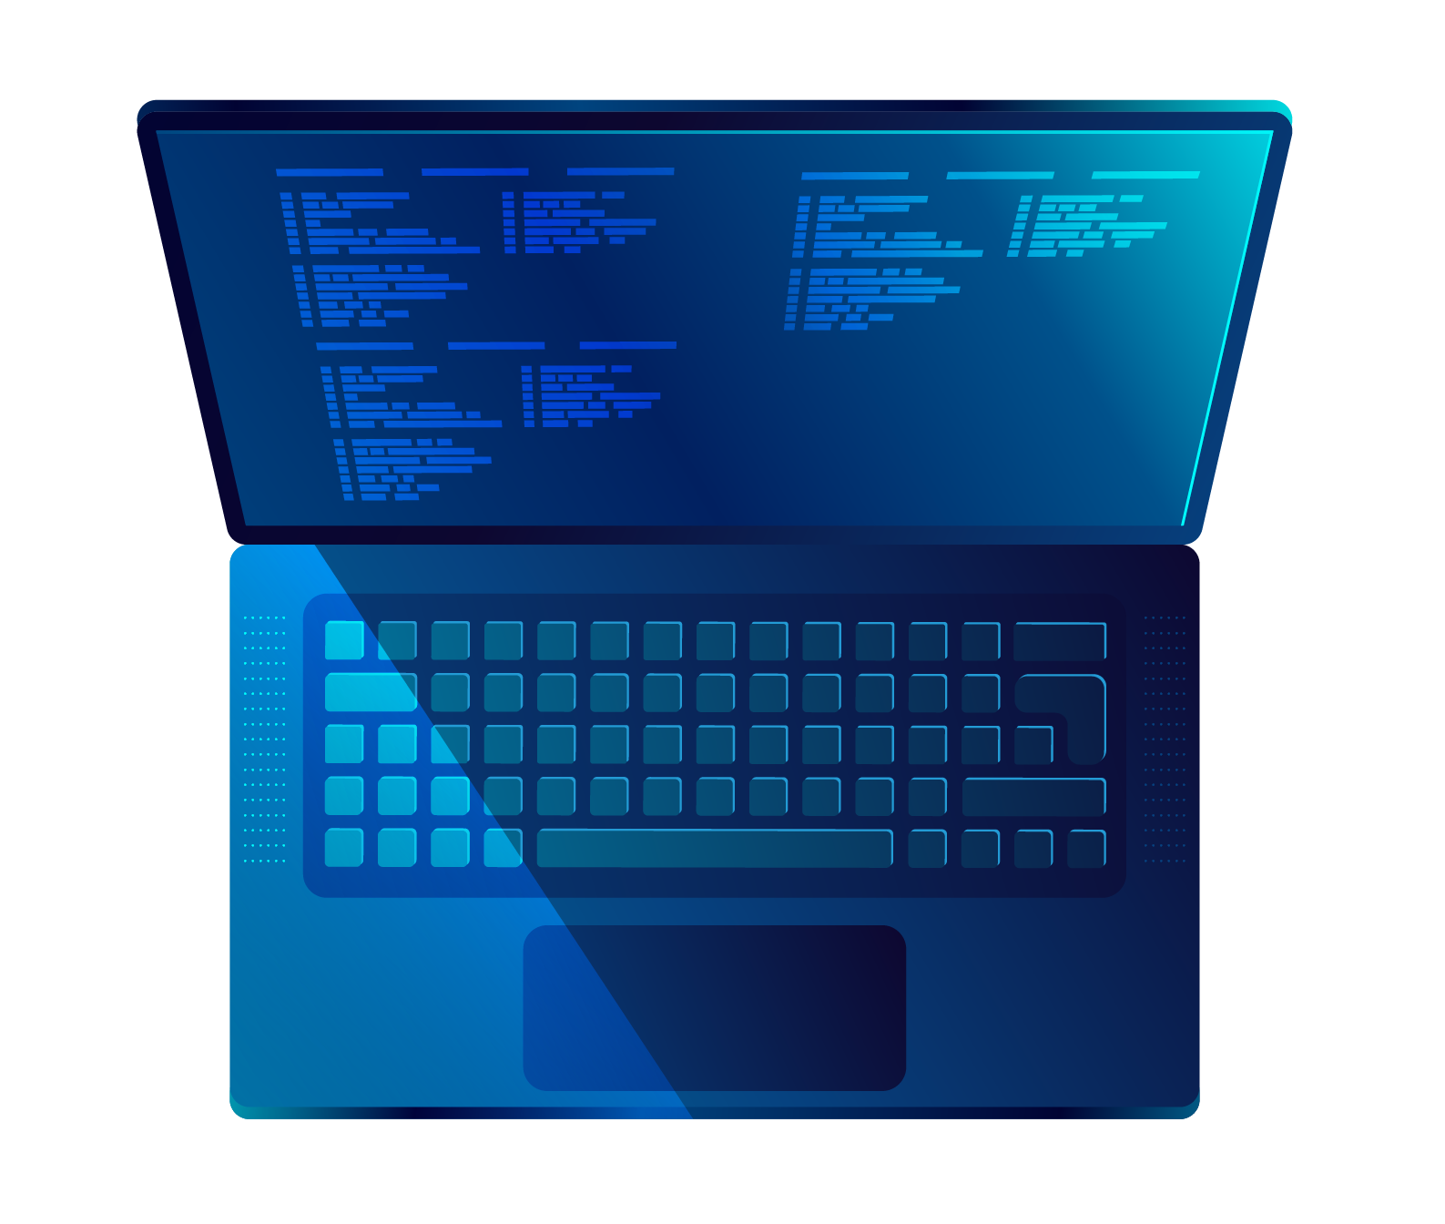
Conclusion
As project managers, we follow three main sections: explaining the purpose of the project, outlining workflow responsibilities, and presenting the completed work.
The project described a thorough effort to develop a productive and easy-to-use rent-a-house management system, combining the advantages of Java swing library for the graphical user interface and PostgreSQL database tools.
Main goal was to create a strong online system for ‘Pater’ that will enhance the management of data and operations in online systems. We have reviewed literature and past successes to determine the best path to reach our objective.

Slide 13
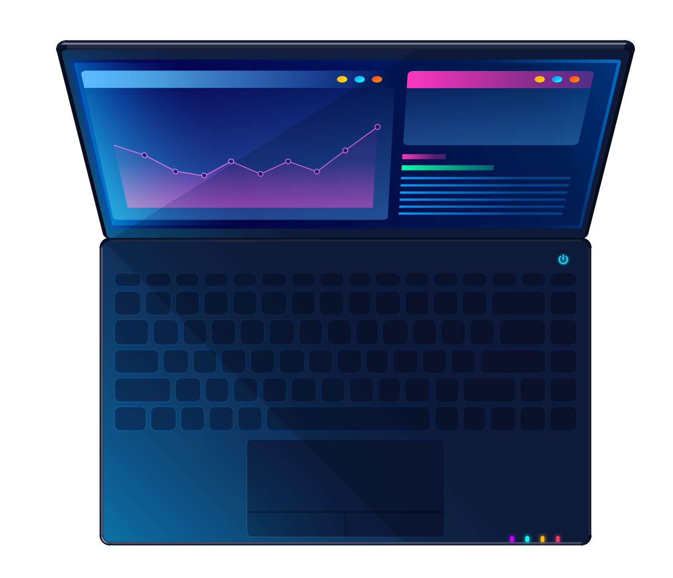
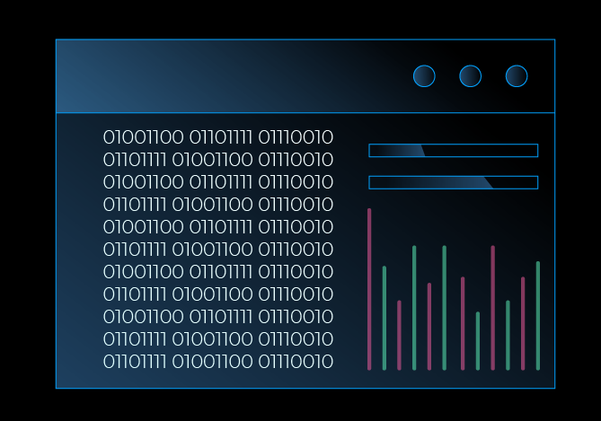
Thanks!
Do you have any questions?

Slide 14
References
1. Stored data in the github https://github.com/Yerassyl04/Rent-a-house-system
2. Stored project in the platform jira https://iskakovk2016.atlassian.net/jira/software/projects/KAN/boards/1/timeline?shared=&atlOrigin=eyJpIjoiZGMwYzU3MDQ5NzllNGJhZThjNjNkOGNiZDVlNzQ2NzAiLCJwIjoiaiJ9

Slide 15
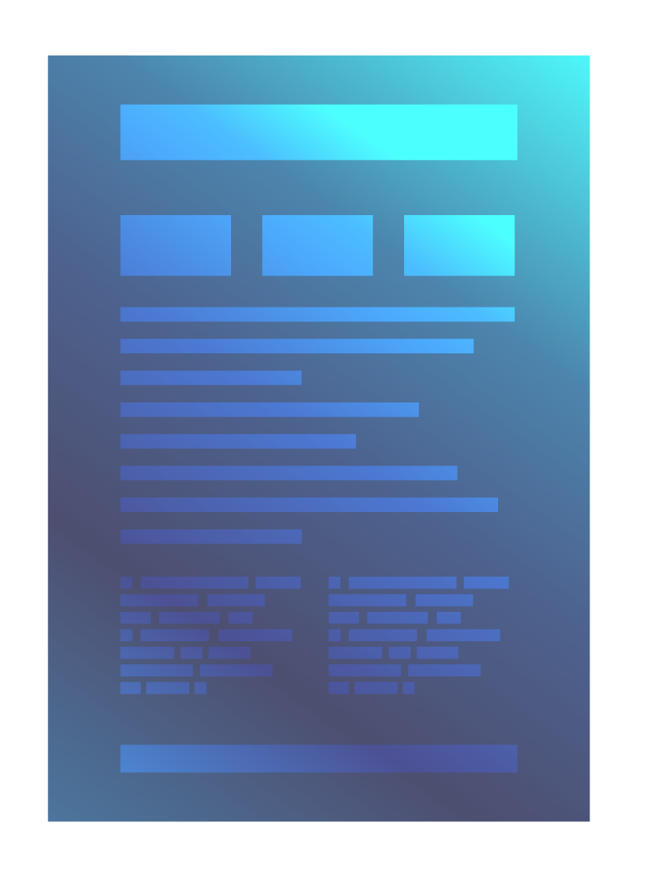

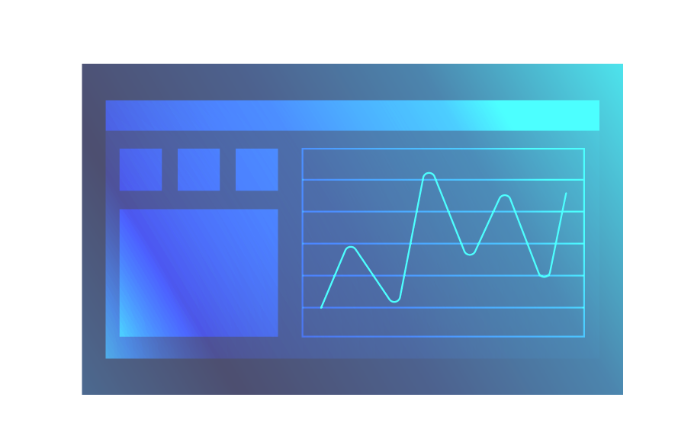
Alternative resources
Here’s an assortment of alternative resources whose style fits the one of this template:
Vectors
Vintage elegant graduation certificate
Top view dark laptop background template

